Slide 1

Nutrition & Health Data Visualization Dashboard
Team B
Yoganandha Banavathu
T.Mary Kumari
Prajit V
Hiranmayi Mula
Varshitha Sri
Harish Ragavendran V
Vignesh N
Vijayalatha P
Adithya Arun

Slide 2

Why Data Visualization Matters in Healthcare
Visualizations transform complex nutrition data into actionable insights. Healthcare professionals can quickly identify patterns, correlations, and anomalies that would be difficult to spot in raw data tables.
Effective visual storytelling helps patients understand their dietary habits and empowers informed health decisions.

Slide 3



Project Objectives
Analyze Nutrition Data
Identify Consumption Patterns
Visualize Health Relationships
Process comprehensive food and nutrient datasets to extract meaningful patterns
Discover trends in meal timing, nutrient distribution, and dietary choices
Illustrate connections between dietary patterns and health outcomes

Slide 4
Dataset Overview
1
2
Daily Food & Nutrition
Disease-Based Nutrition
10,000+ food entries tracking 150+ nutritional attributes across meal types, portion sizes, and timing
5,000+ patient records linking dietary patterns with diagnosed conditions including diabetes, hypertension, and cardiovascular disease
Both datasets include timestamps, demographic information, and detailed nutrient breakdowns for comprehensive analysis.

Slide 5








Key Nutritional Variables
Macronutrients
Vitamins
Calories, Protein, Carbohydrates, Fat
A, B, C, D, E, K
Meal Context
Minerals
Meal Type, Water Intake, Disease Label
Calcium, Iron, Magnesium, Zinc

Slide 6





Visualizations Created
Bar Charts
Nutrient comparison across meal types and disease categories
Pie Charts
Meal distribution and macronutrient composition breakdowns
Line Charts
Daily calorie trends and temporal consumption patterns
Heatmaps
Nutrient correlation matrices identifying relationships

Slide 7

Key Insights from Data
Highest Calorie Meals
Dinner consistently shows 35% higher calorie intake compared to breakfast and lunch. Evening meals average 850 calories versus 450-600 for other meals.
Nutrient Imbalances
70% of analyzed diets show protein deficiency while exceeding recommended sugar intake by 45%.

Slide 8
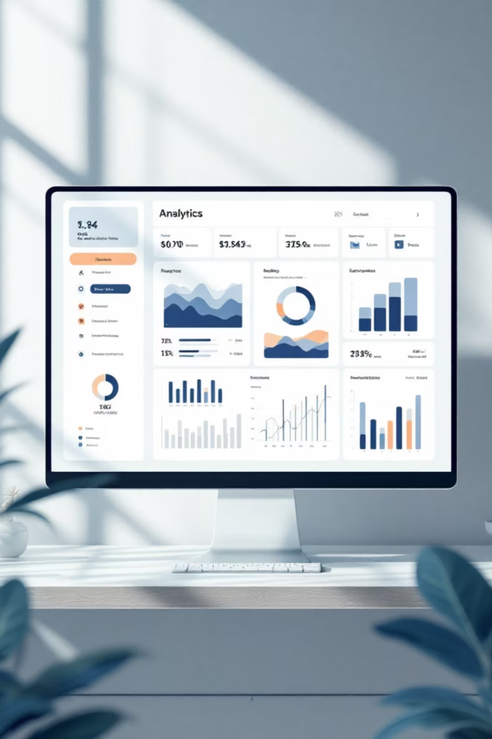
Interactive Dashboard Features
01
02
Dynamic Filters
Real-Time Updates
Filter by meal type, disease category, or specific nutrients
Instantly refresh visualizations as filters change
03
Clean UI
User-friendly design with consistent color scheme

Slide 9
Key Findings
45%
3.2x
850
Average Excess
Disease Correlation
Dinner Calories
Sugar intake above recommended daily limits
Higher risk with imbalanced macronutrient ratios
Average evening meal compared to 500 recommended
Takeaway: Balanced nutrition is critical. Visualizations reveal that most diets exceed calories in evening meals while lacking essential nutrients throughout the day.

Slide 10

Conclusion
Data Visualization Simplifies Complexity
Transforming raw numbers into visual stories makes complex nutritional data accessible to healthcare providers and patients alike.
Empowers Better Decisions
Clear visualizations help users understand dietary patterns and make informed health choices.
Real-World Applications
This framework can be extended to mobile health apps, clinical decision support systems, and personalized nutrition platforms.

